Slide 1
Petition in relation to the Rising Sun PH (20/AP/1374)
Output of the Online and Written Petition
Online Petition. At the date of 17th July 2020 there were a total of 218 signatures. The wording of the online petition which was displayed on Change.org
https://www.change.org/p/southwark-council-save-the-rising-sun-public-house-harper-road-se1
We are calling upon Southwark Council to say no to demolishing the Rising Sun Public House (98 Harper Road, SE1 6AQ). The Rising Sun is the last public house on the Rockingham Estate and is a friendly hub for the local community. It is extremely successful and heavily used by local people. It is home to 5 darts teams, live bands, discos and Elvis (once a month!). The pub is frequently used for filming (including the Michael Caine film Harry Brown and the In-Betweeners).
In their planning application (Southwark Council (https://planning.southwark.gov.uk/online-applications/ (20/AP/1374)), the developer wants to demolish the pub and replace it with a tower and gallery at ground floor. If you have a little time, the grounds for objection and how to object can be seen at:
https://www.walworthsociety.co.uk/post/walworth-society-w-c-15th-june-virtually-walworth-events-latest-news (see point 4)
Please do support this great local pub by signing the petition and, if possible, objecting to the planning application.
In addition 17 comments were made in relation to the Online Petition – these are also included

Slide 2
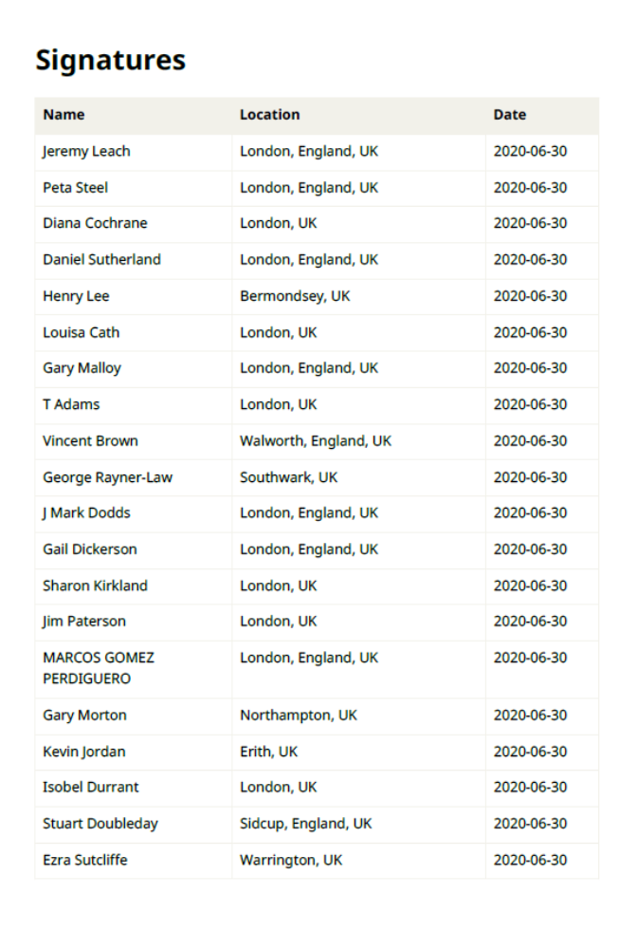

Slide 3
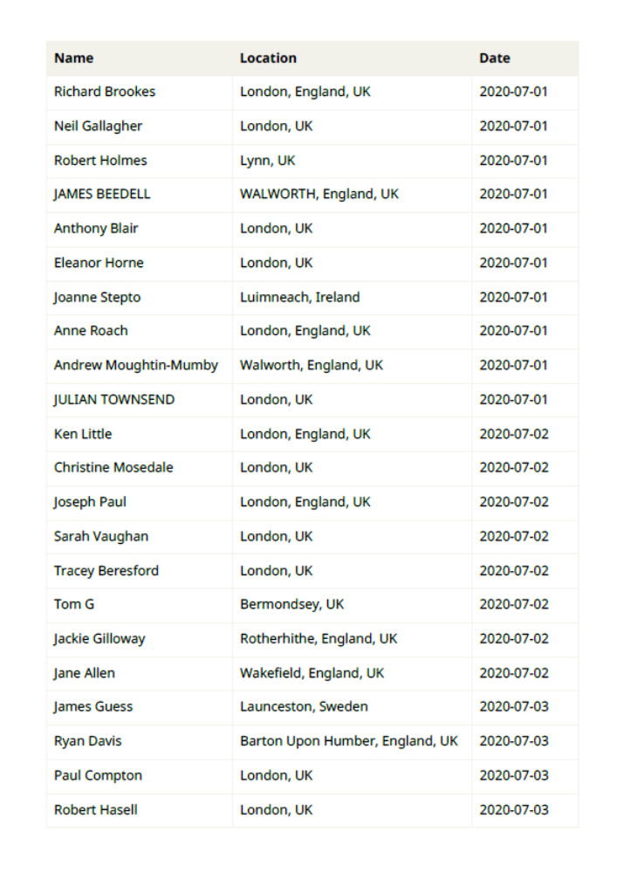

Slide 4
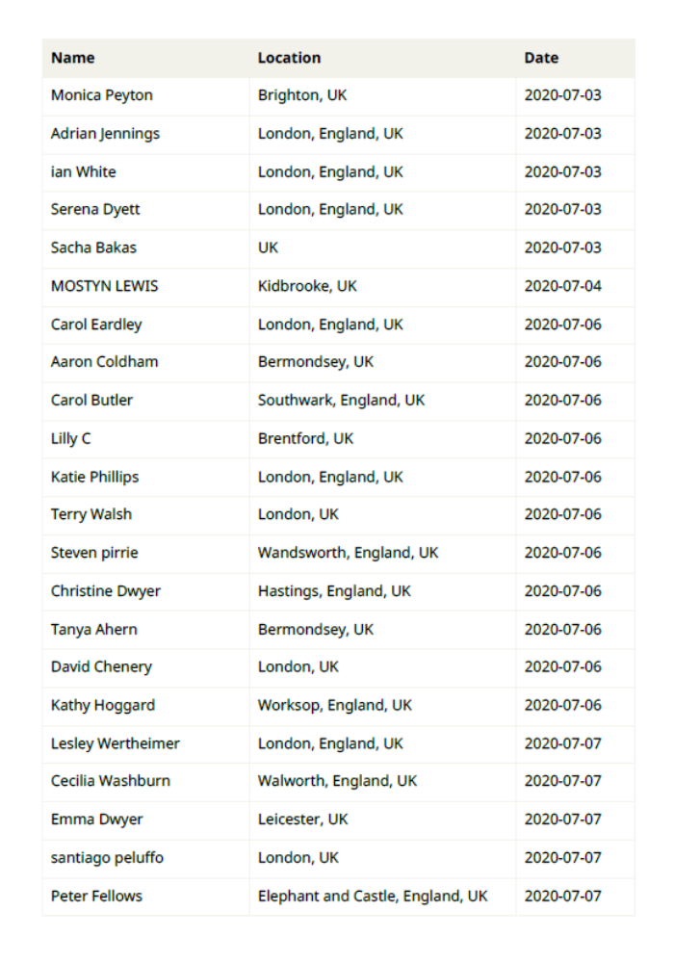

Slide 5
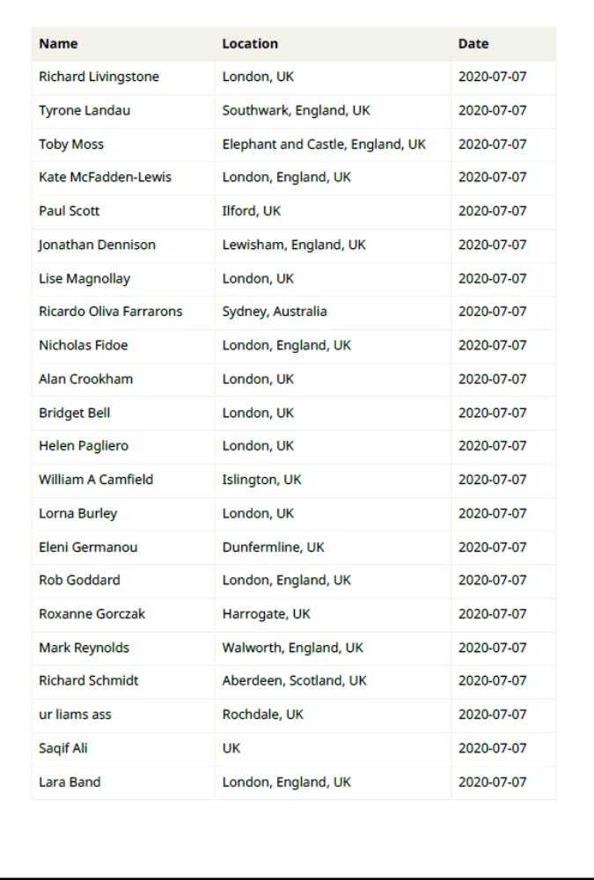

Slide 6
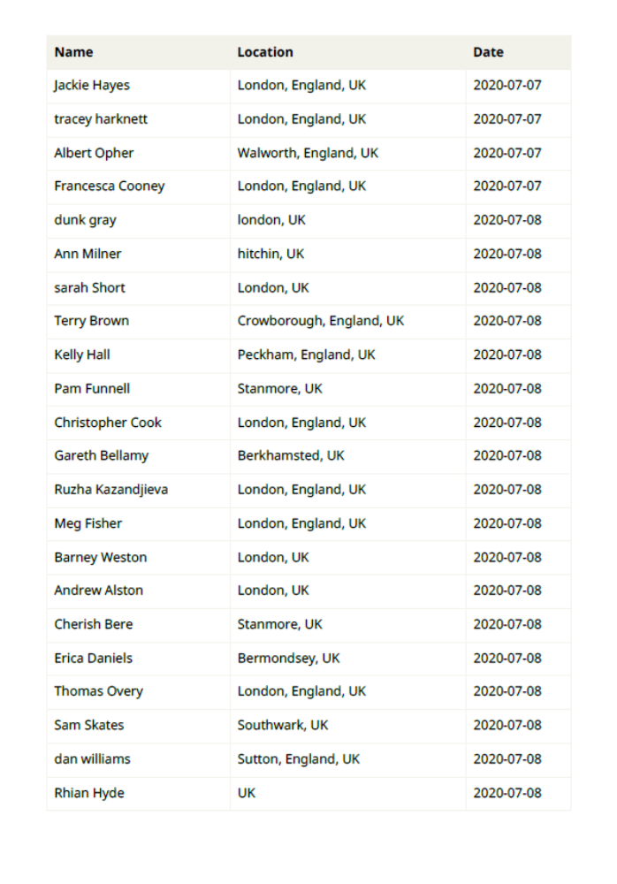

Slide 7
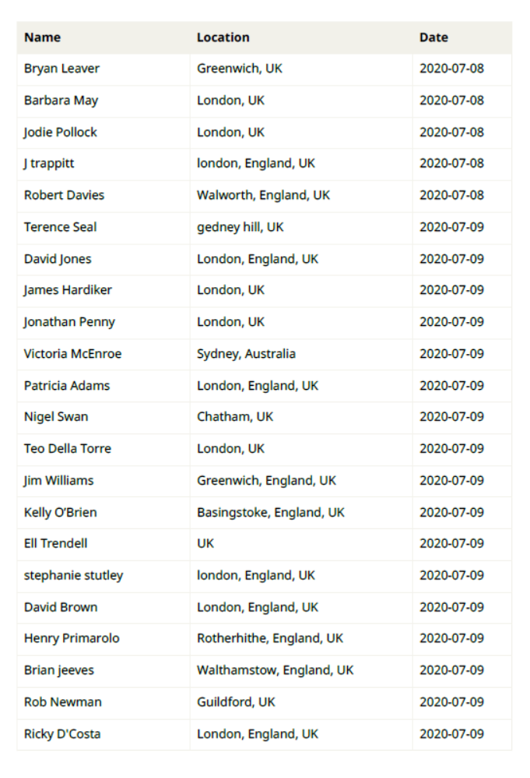

Slide 8
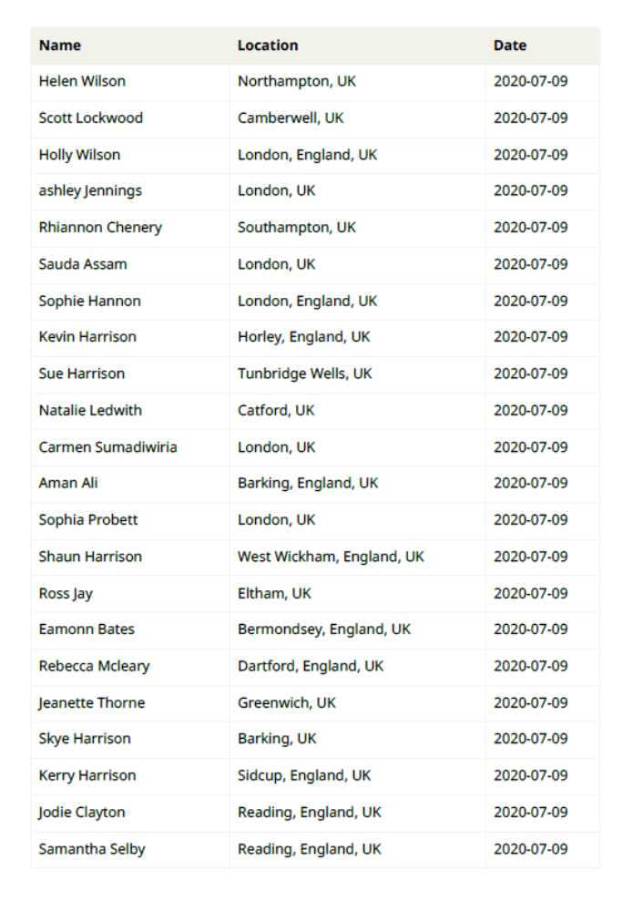

Slide 9
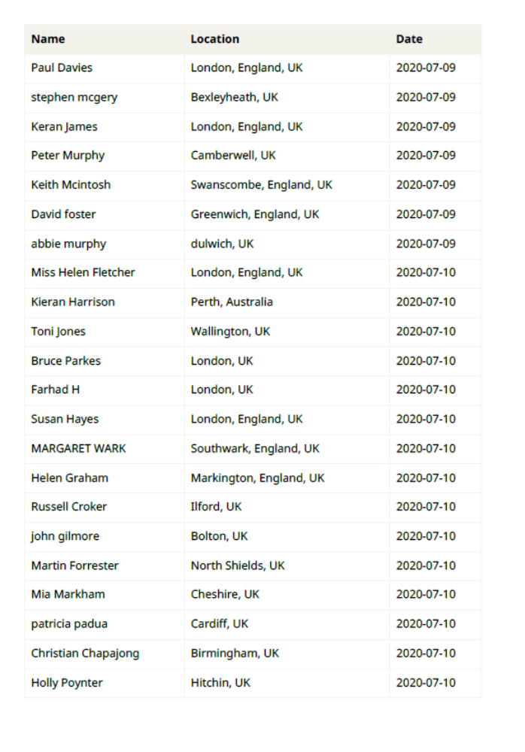

Slide 10
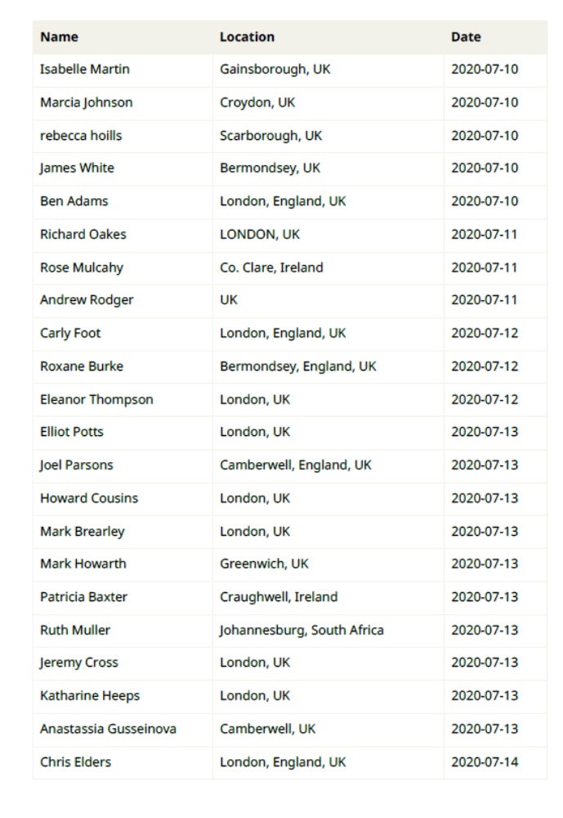

Slide 11
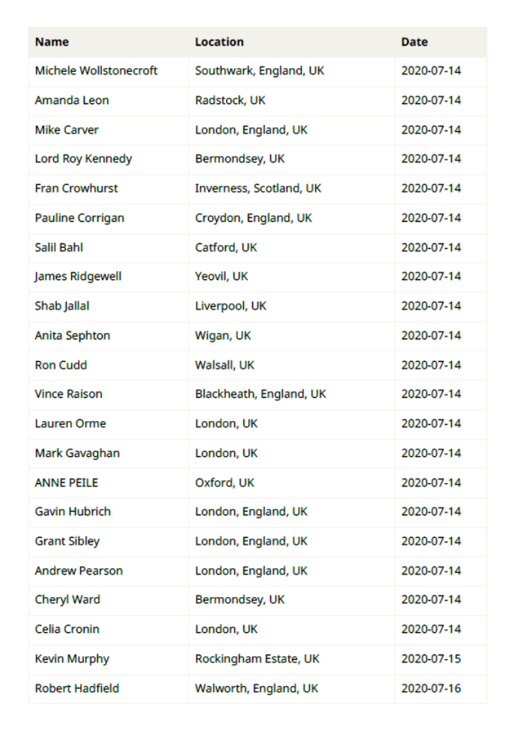

Slide 12
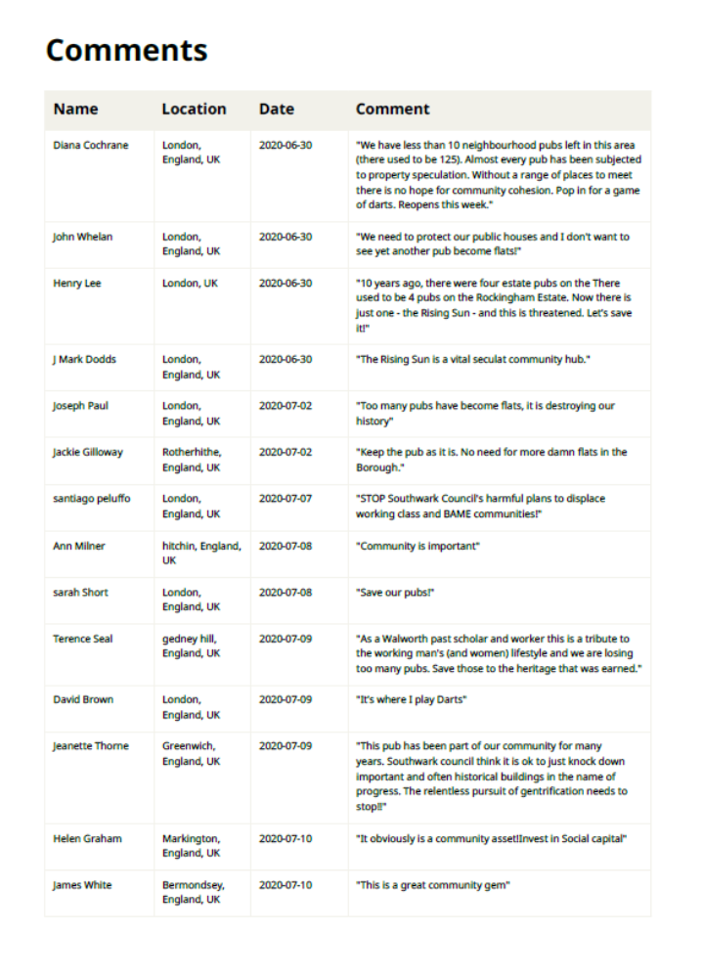
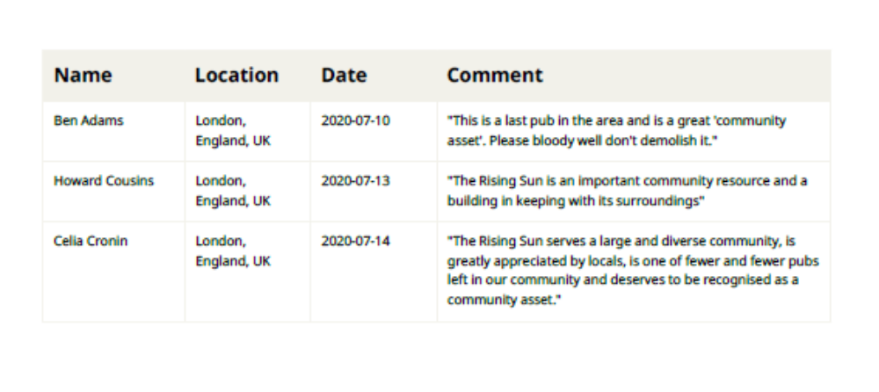

Slide 14
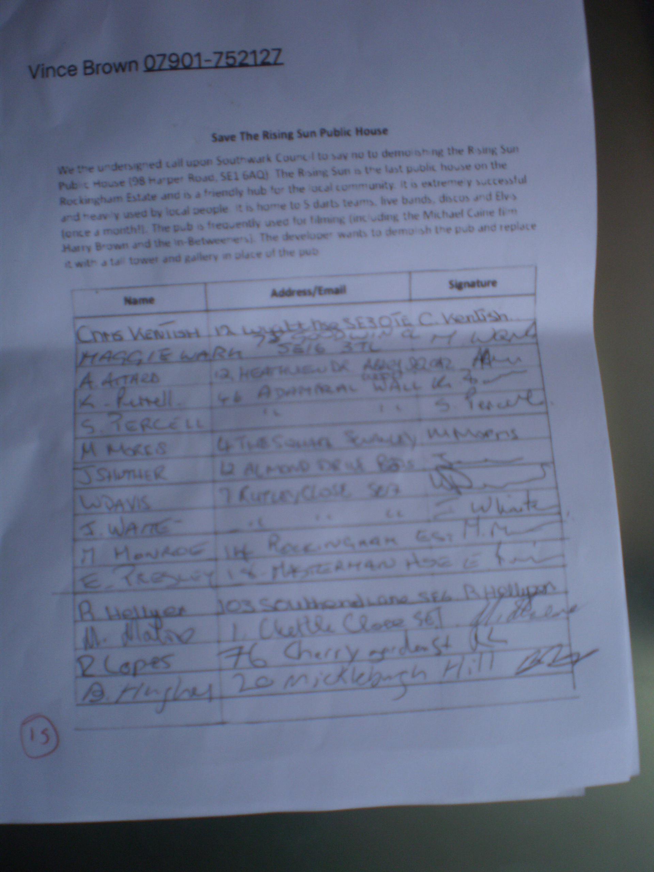
Petition in relation to the Rising Sun PH (20/AP/1374)
Output of the Online and Written Petition
2. Written Petition. Total of 173 signatures

Slide 15
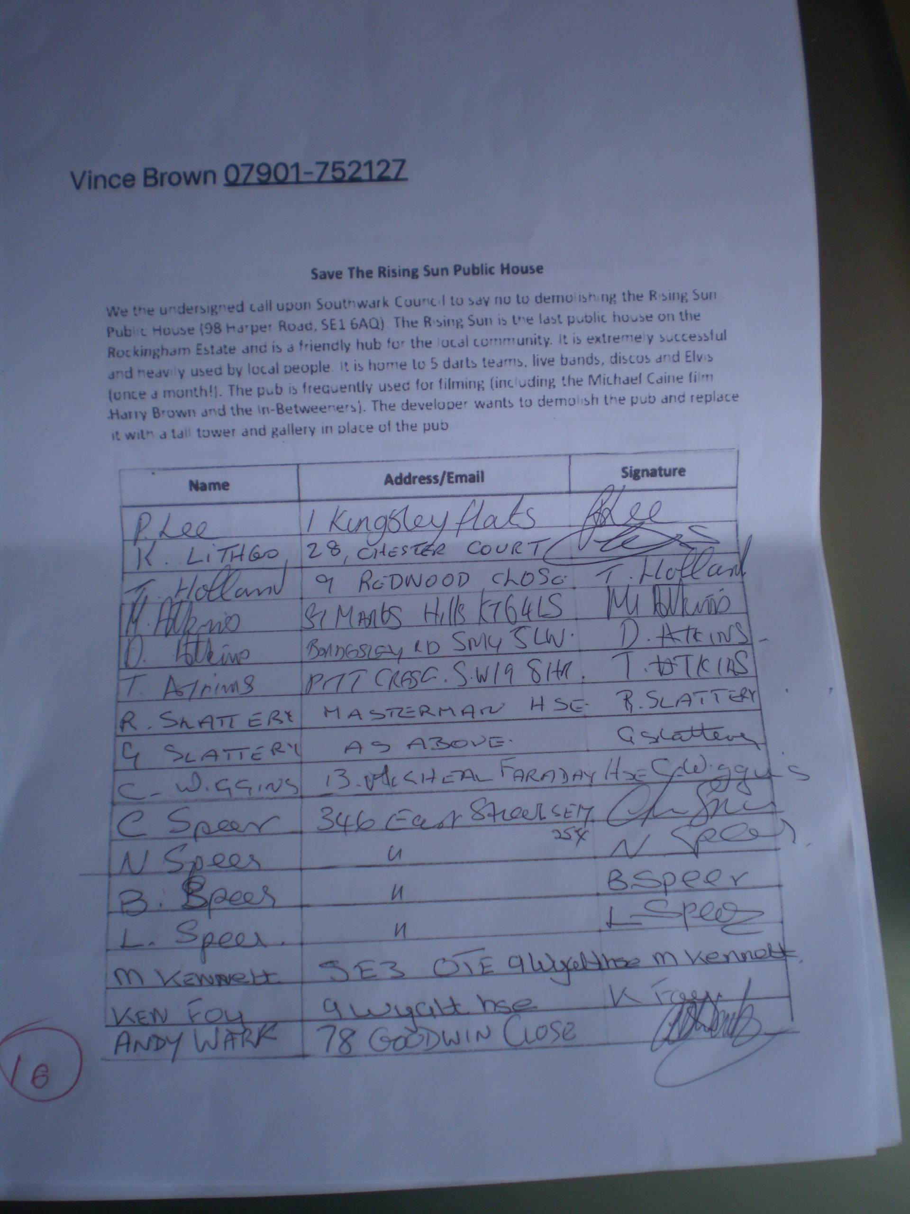

Slide 16
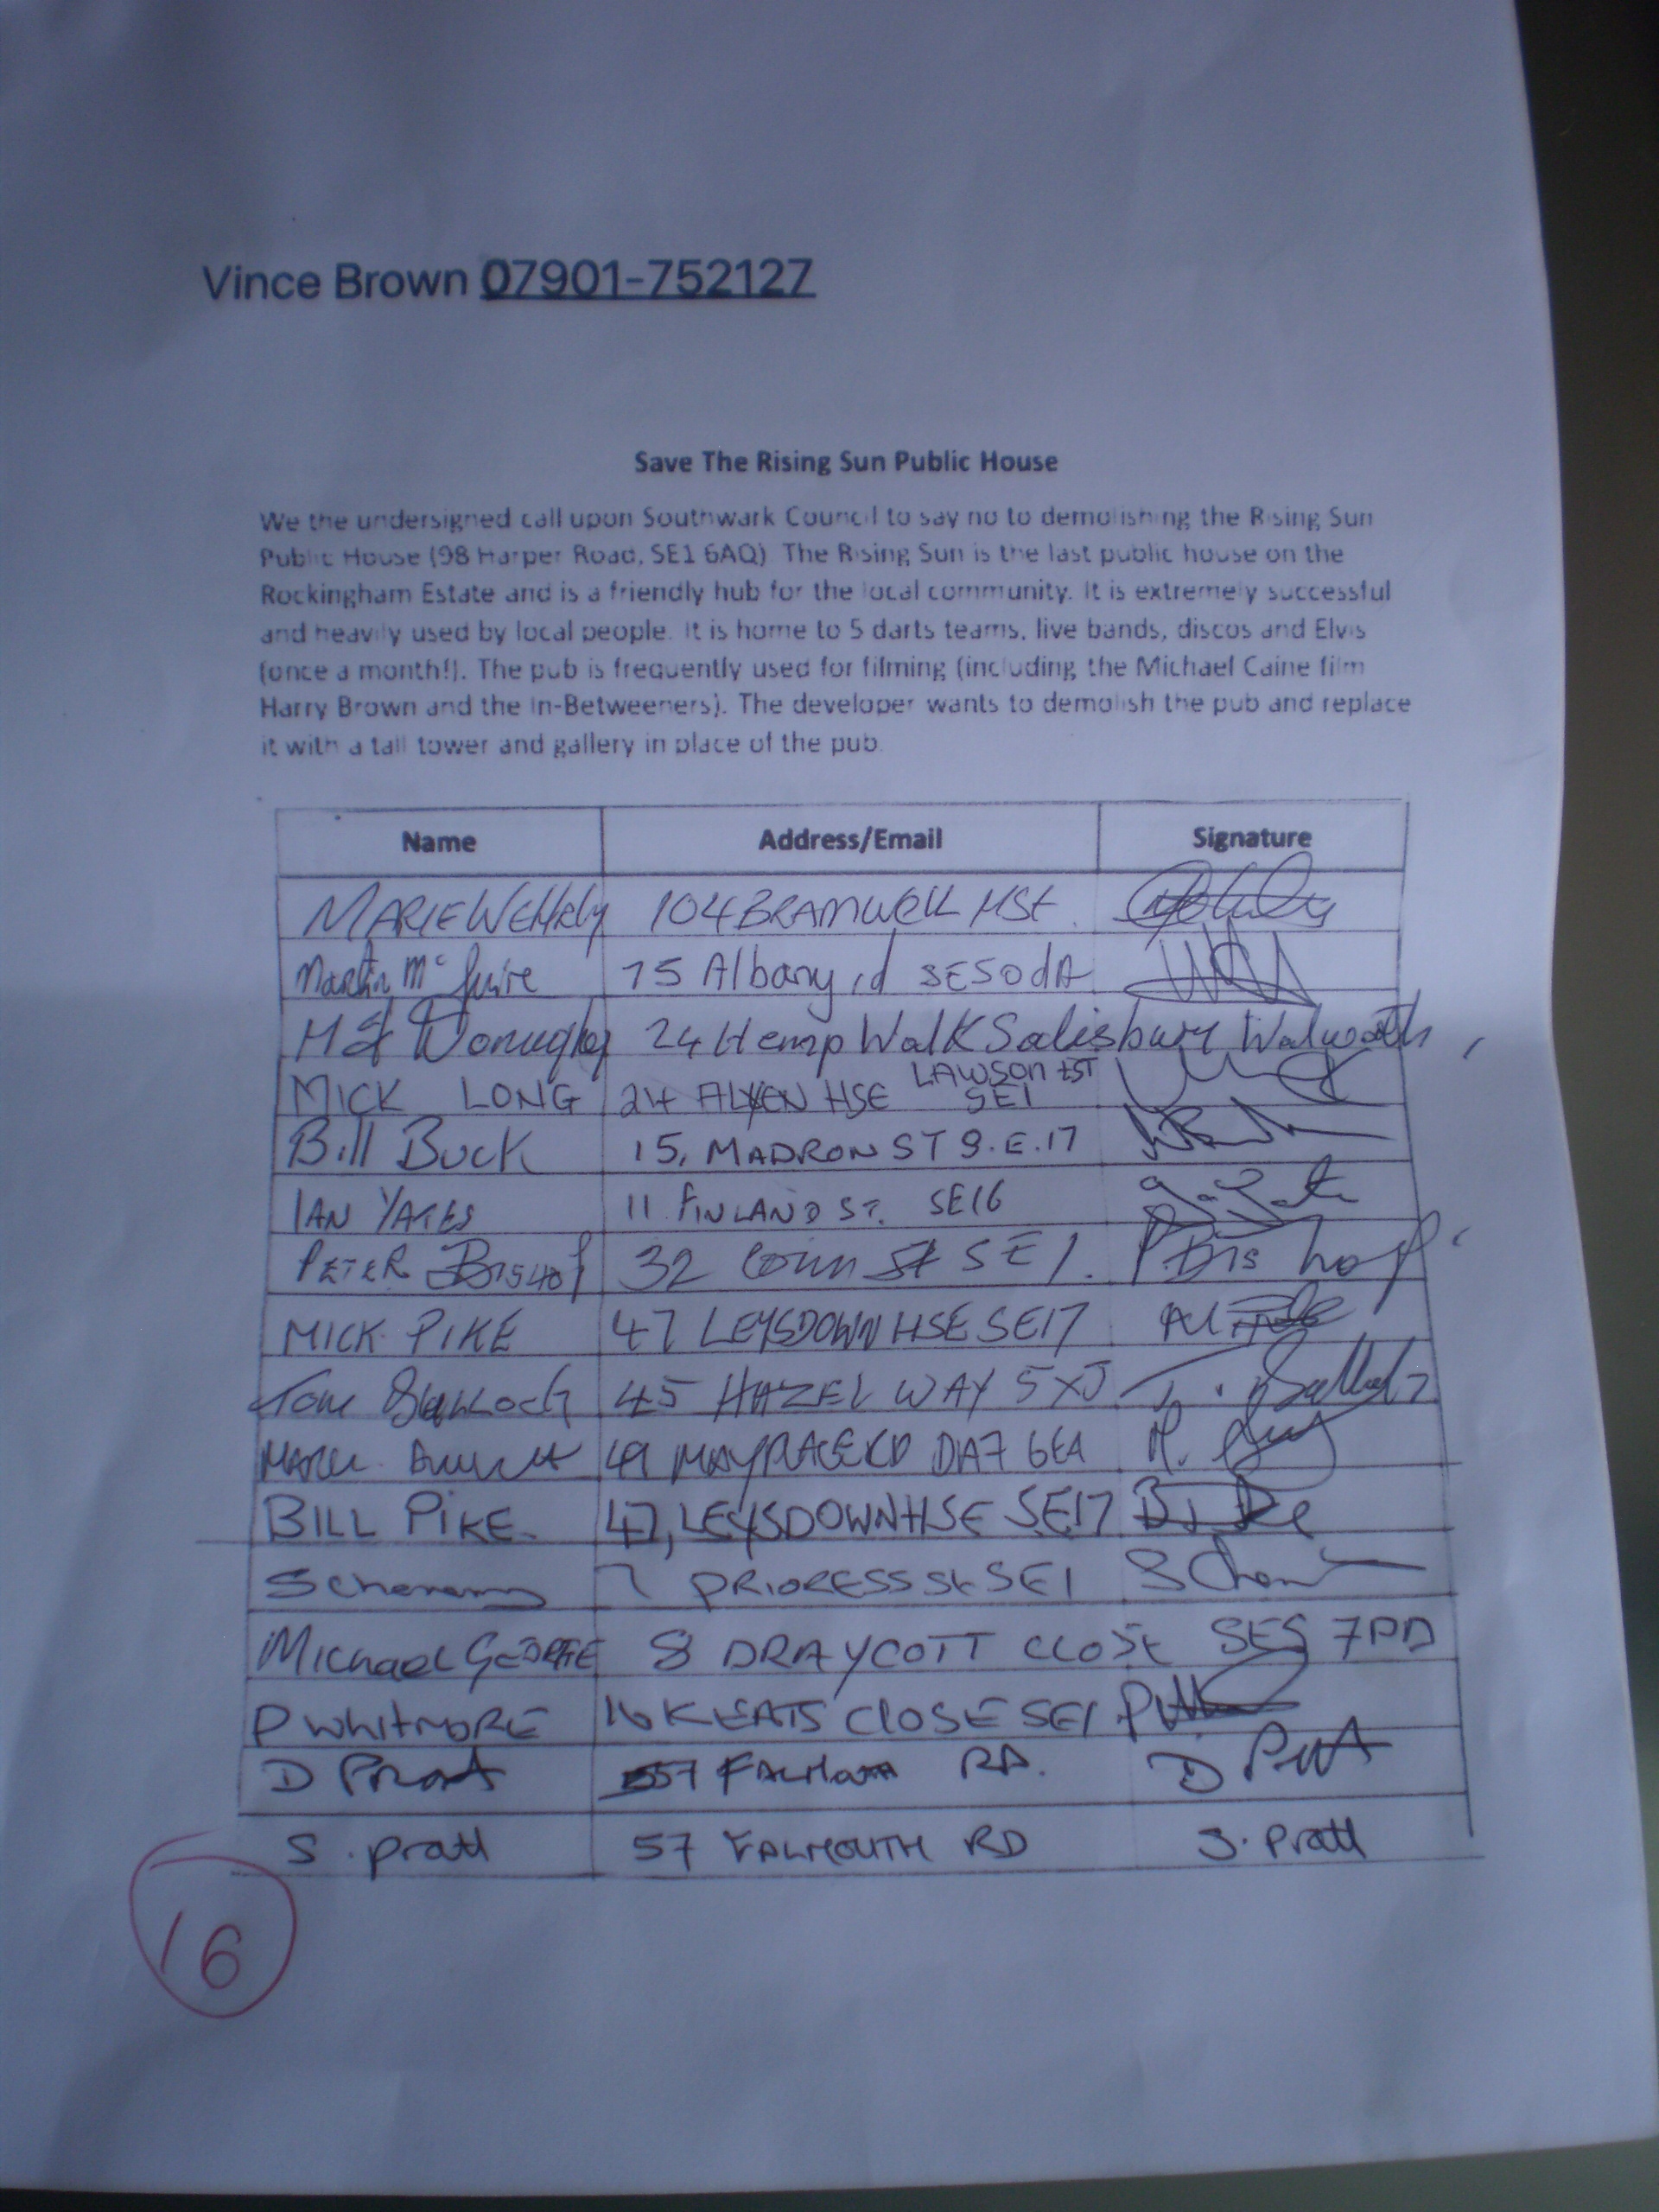

Slide 17
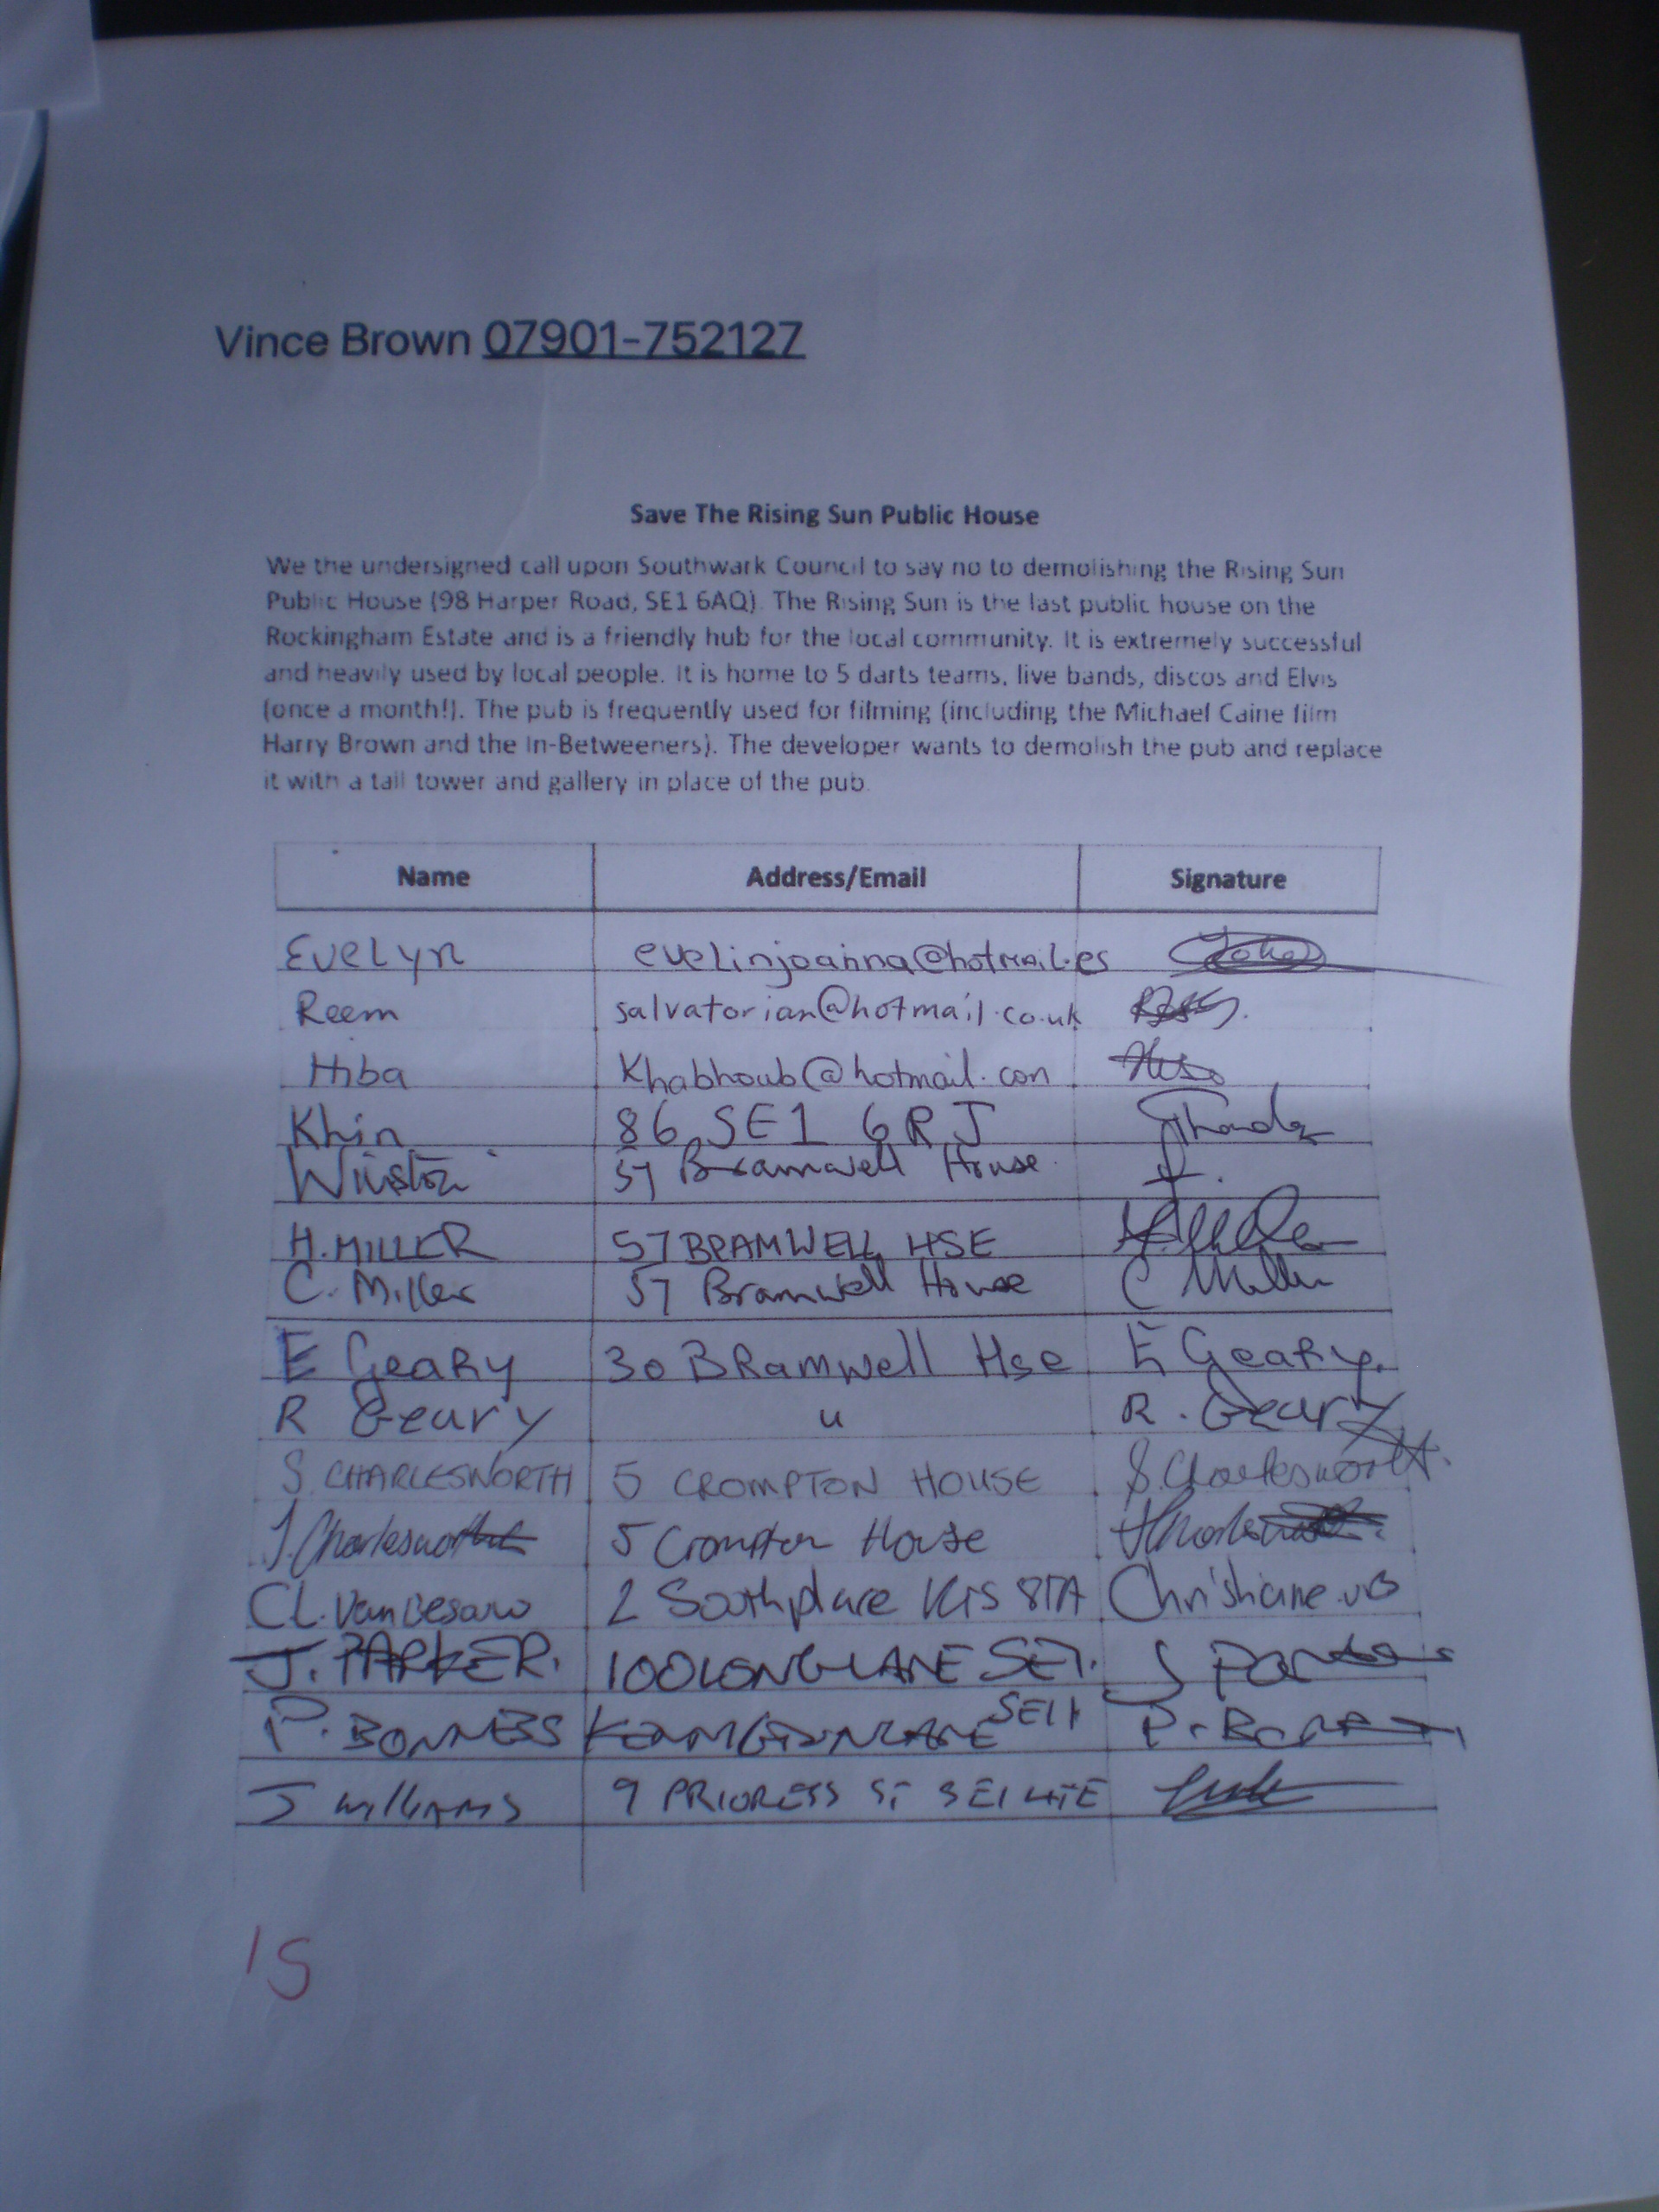

Slide 18
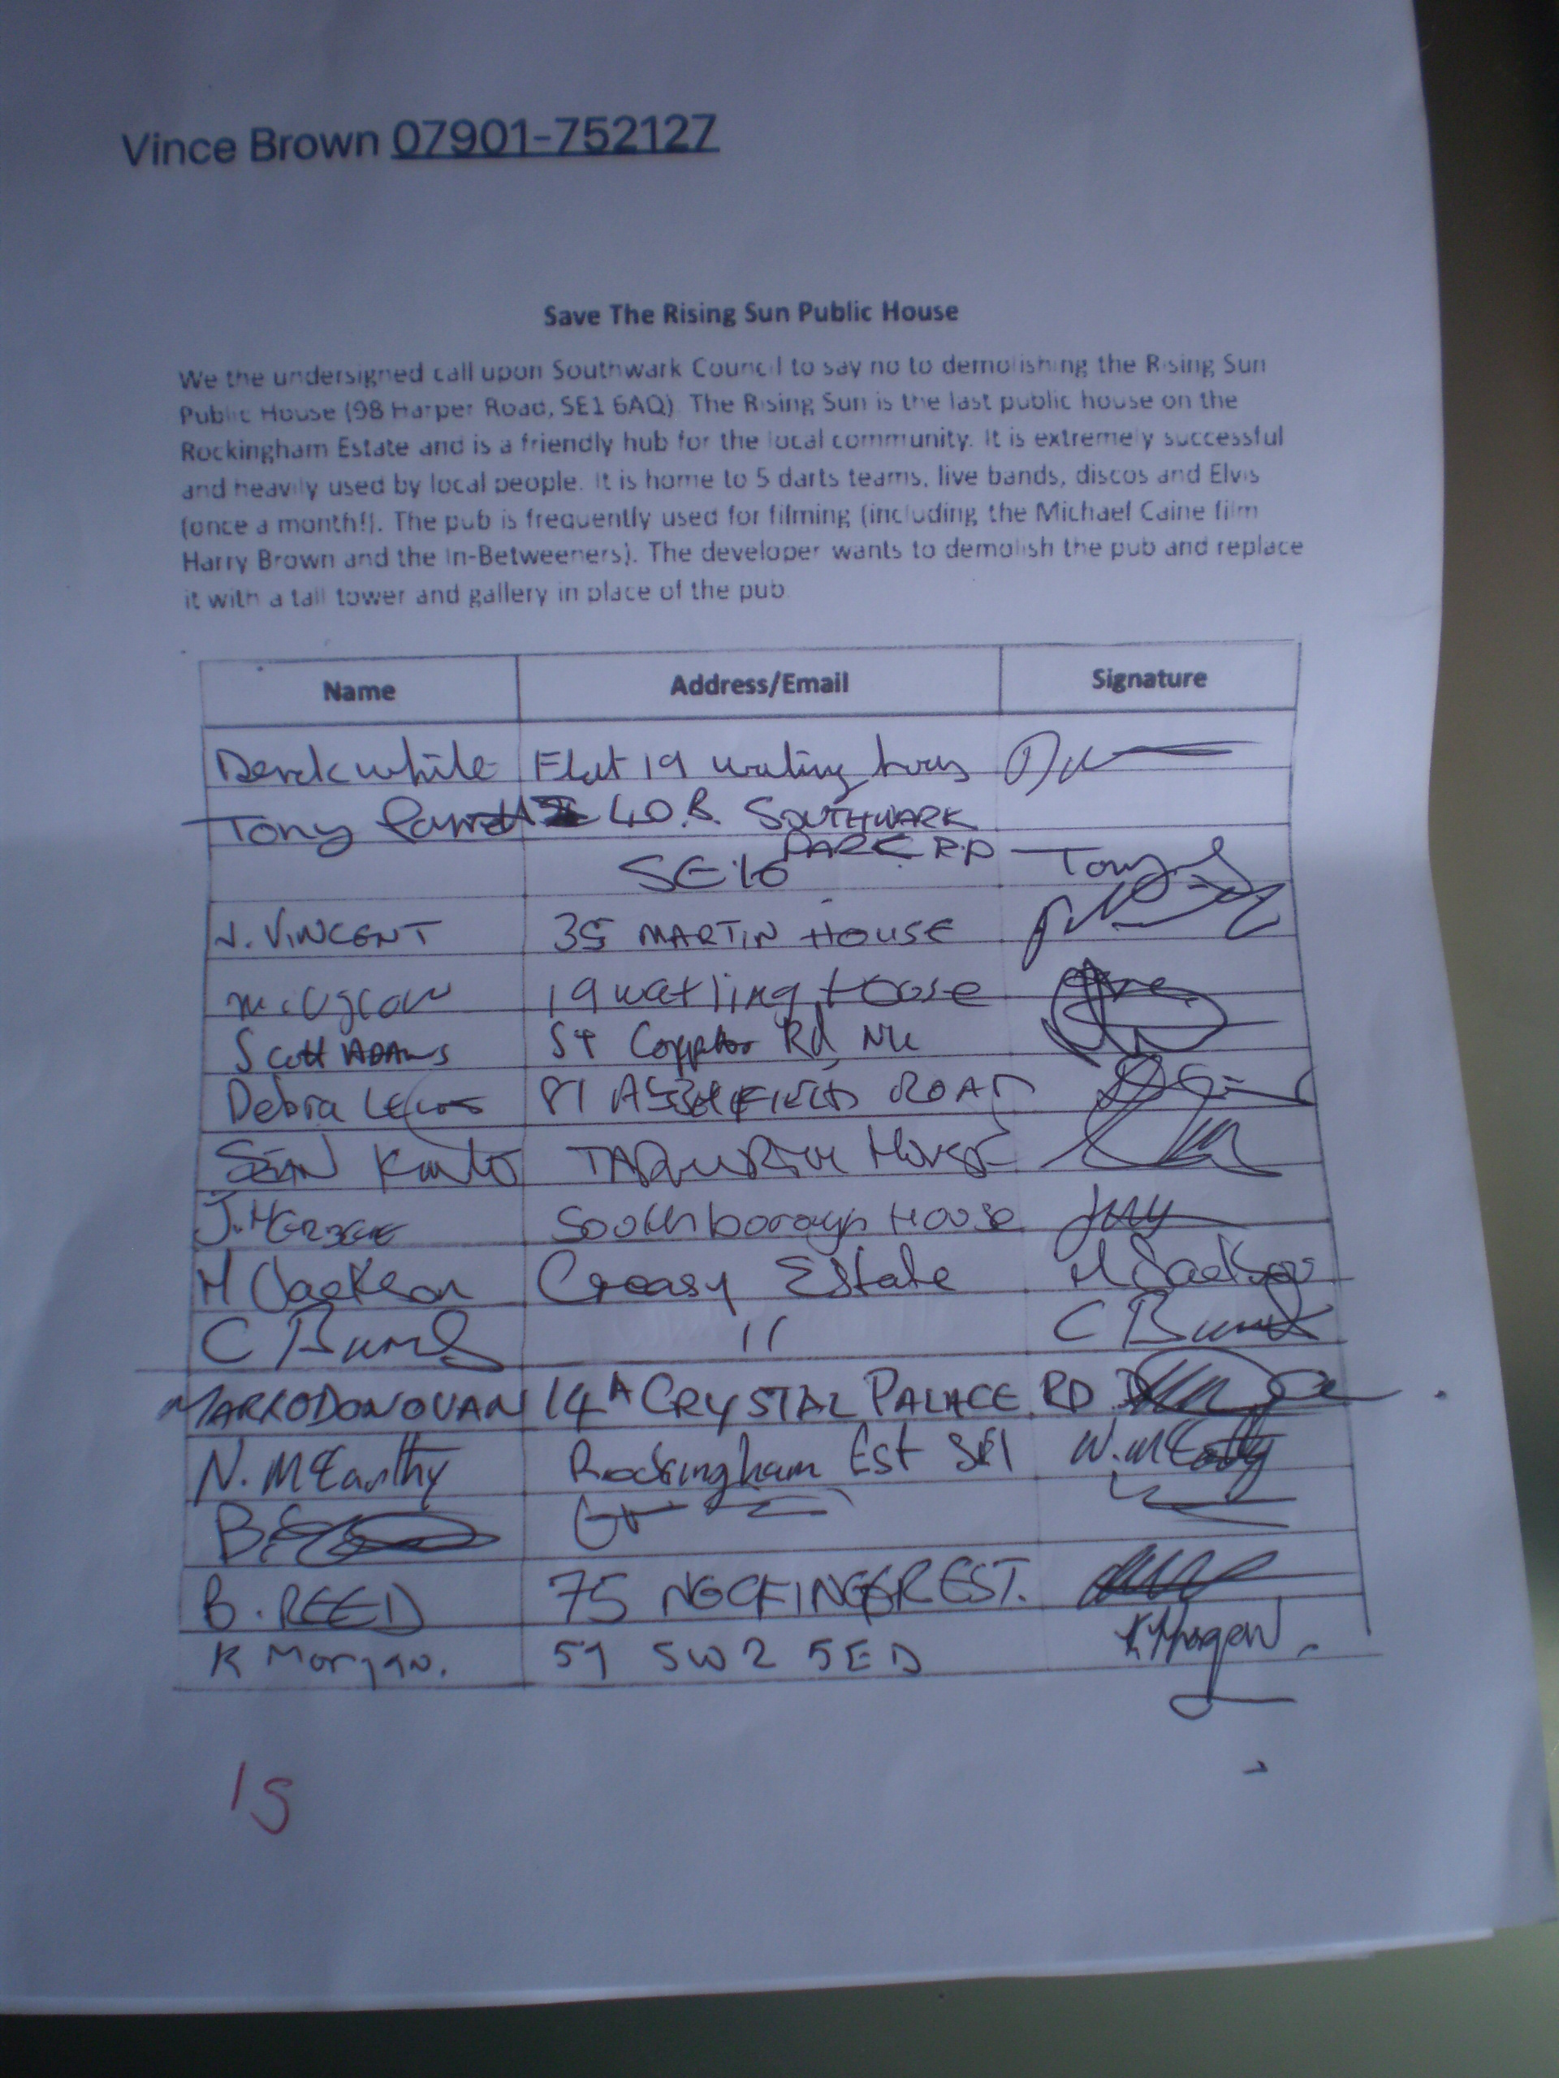

Slide 19
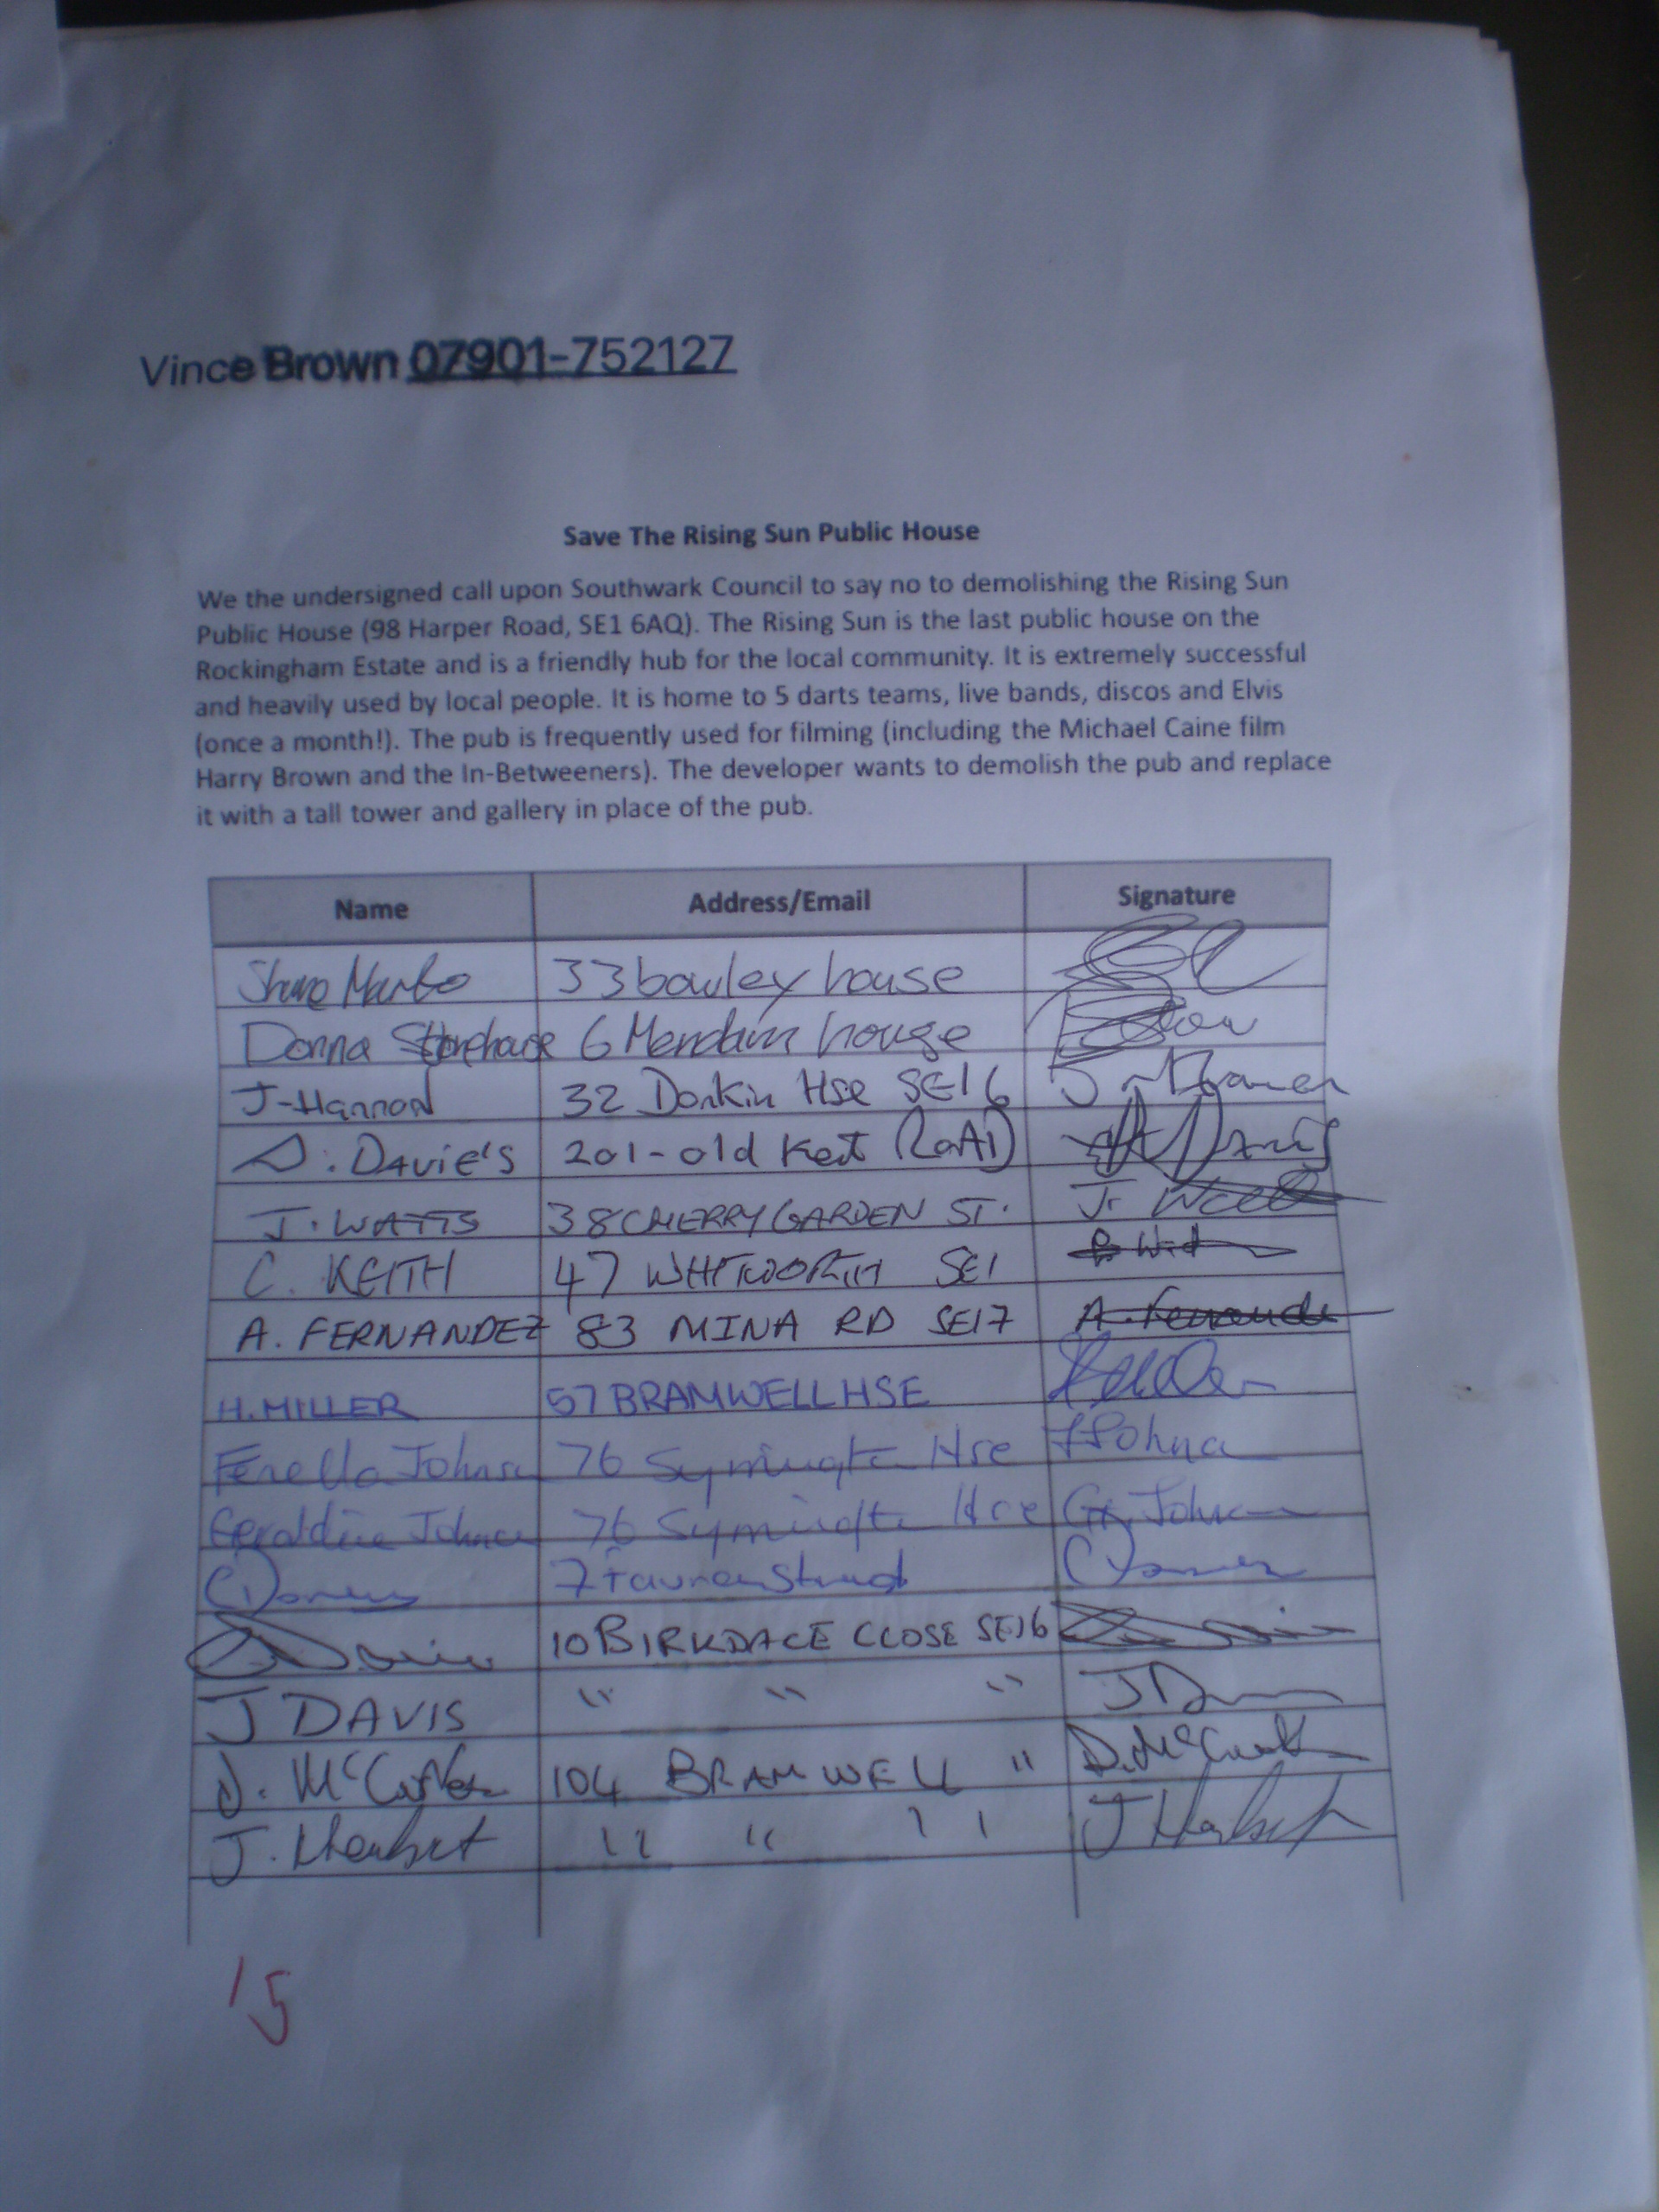

Slide 20
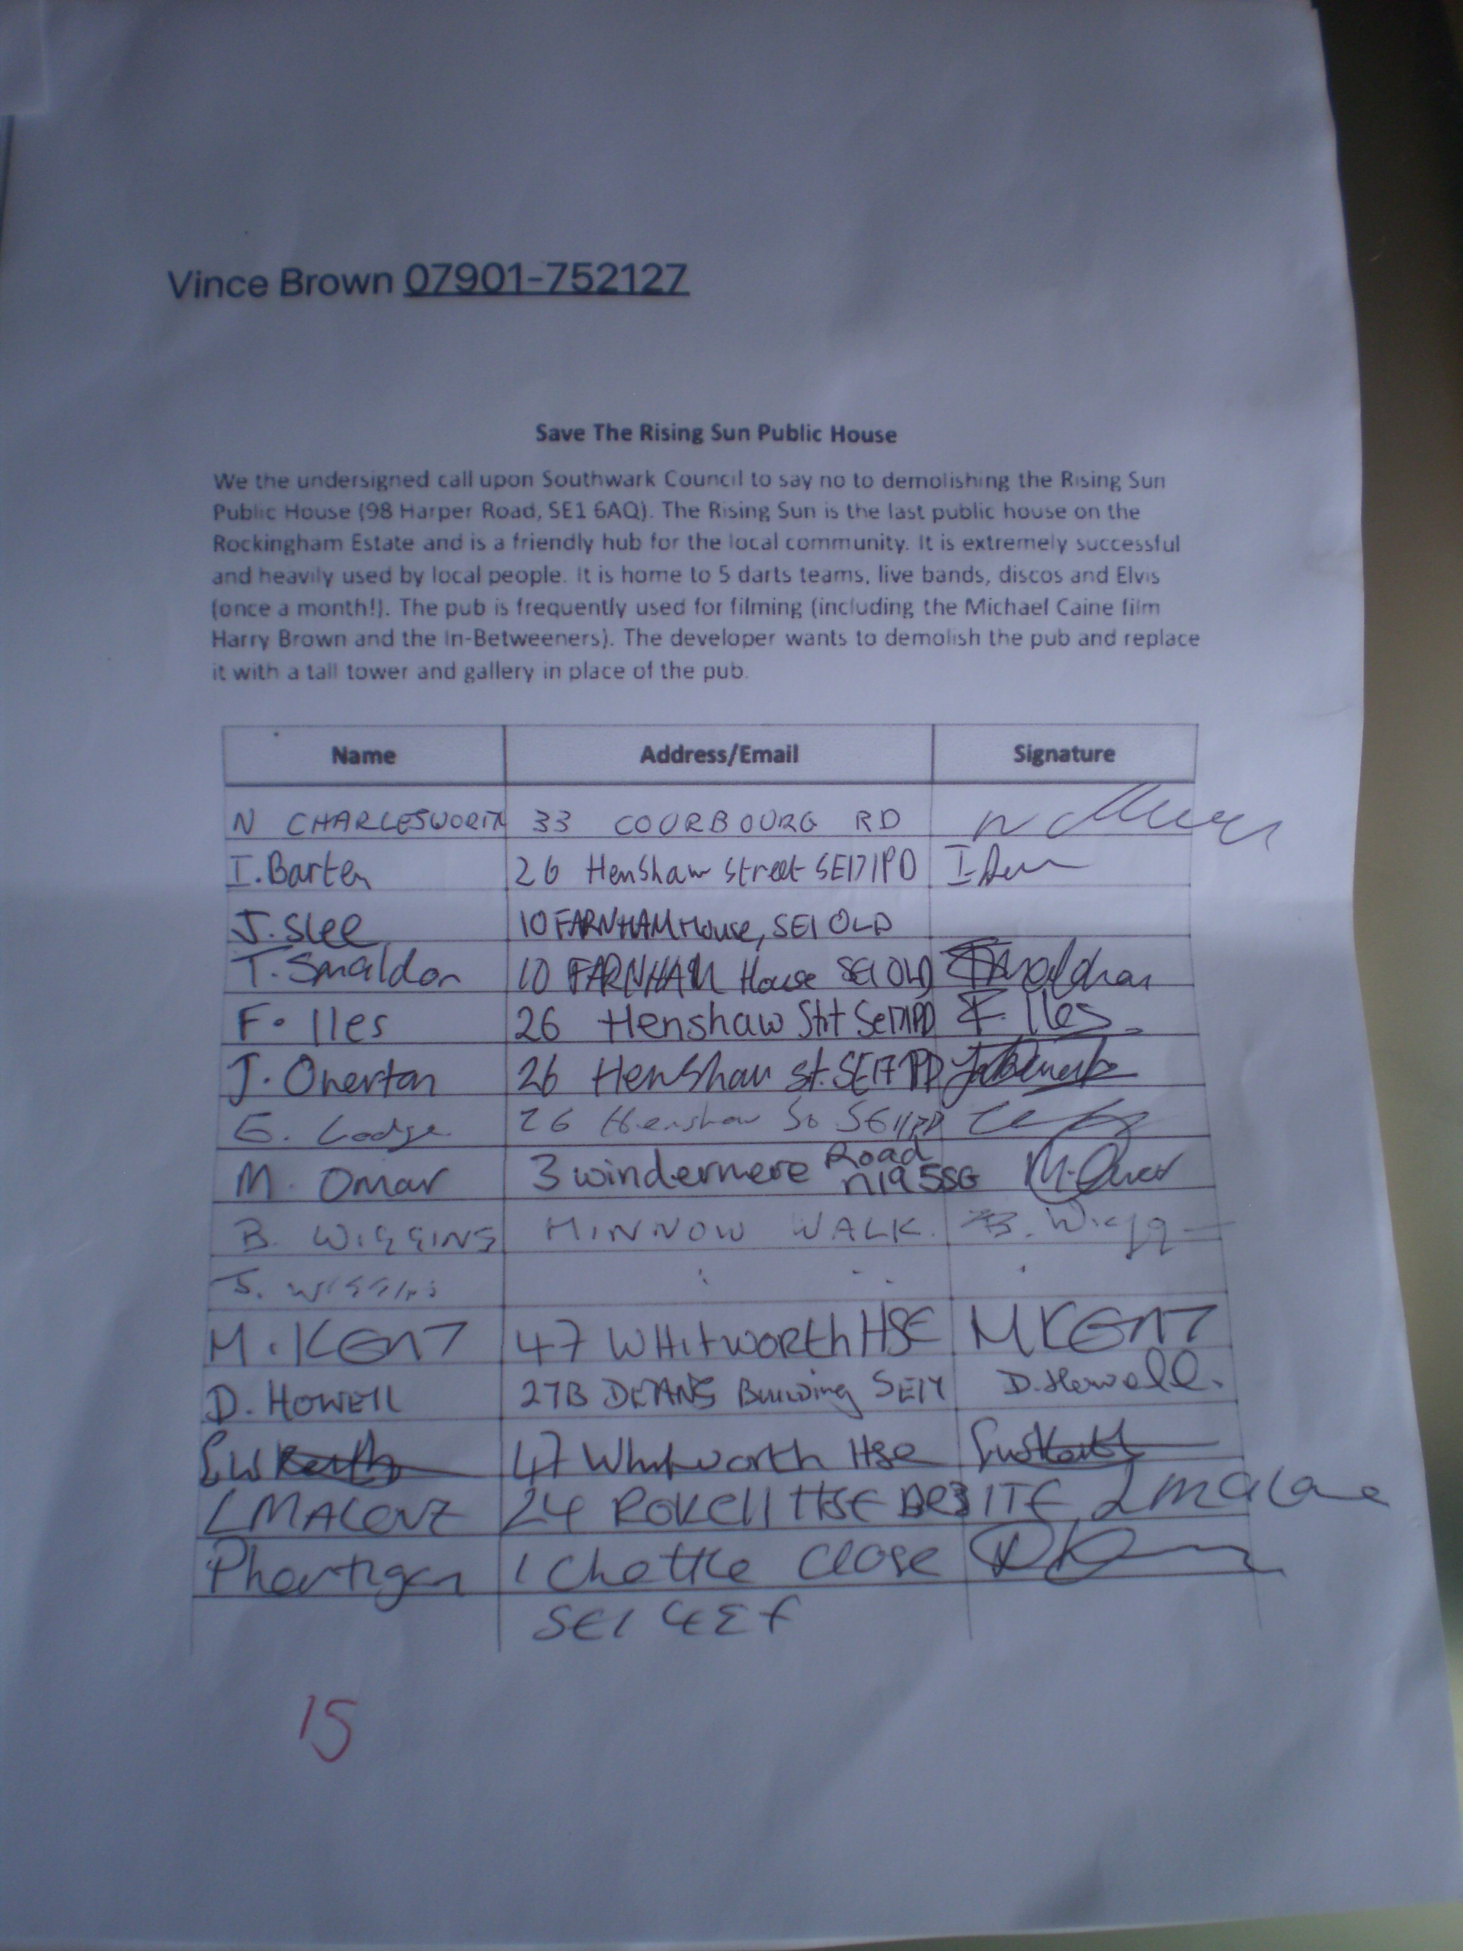

Slide 21
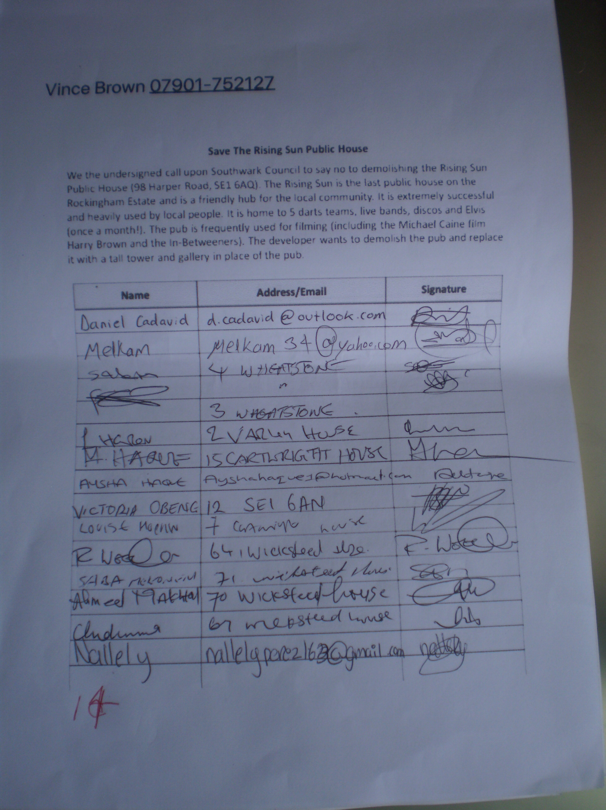

Slide 22
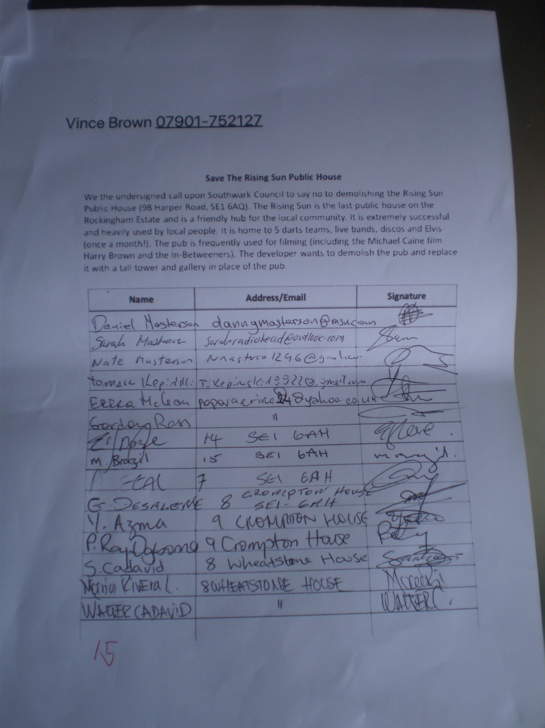

Slide 23
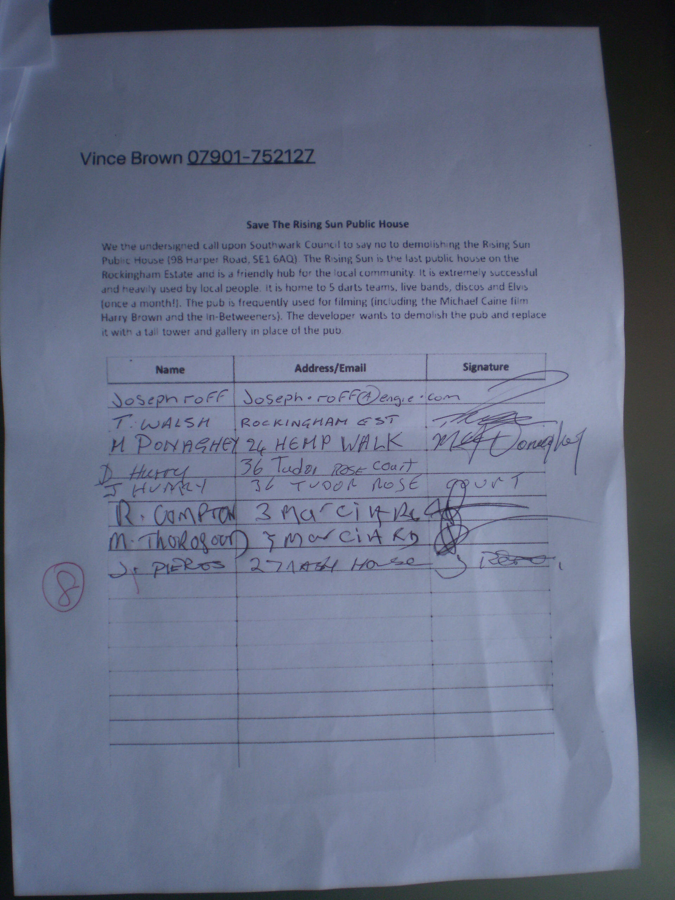

Slide 24
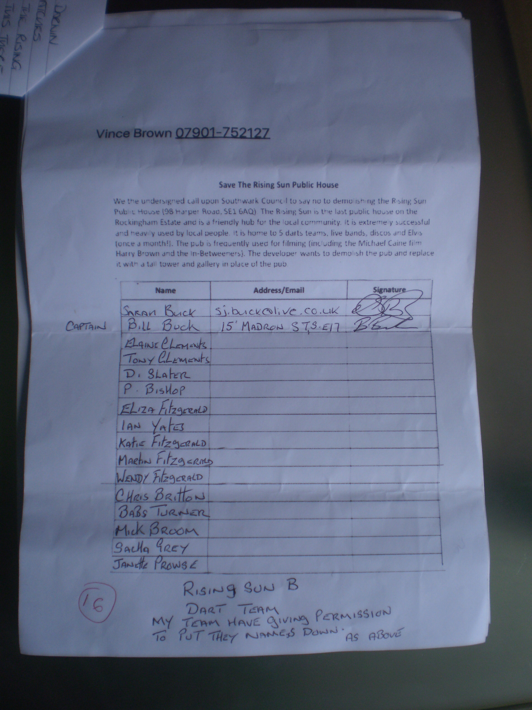

Slide 25
